Slide 1
TATA GROUP
A GLOBAL VENTURE

Slide 2
Features of top global brands
Extraordinary depth of management talent -allows them to out-think the competition and survive changes in leadership.
The best advice from their global media, advertising and research agencies.
Global Research and Development capabilities- provide a constant stream of innovation and can readily adapt existing products and services to meet new market needs.
Experience - understanding of what is likely to work in a new market based on experience elsewhere.
Big marketing budgets with which to establish their brands – strong presence and distinct identity.

Slide 3
Channels Available
Textual channels
Twitter, facebook, blogs
Video/photography
Instagram, facebook, snapchat, youtube
More detailed accounts can be given
Non appealing
Content based
More scope for creativity
Visually appealing, easier to access, more reach
User generated content easier to come by
Old school
Newspapers, magazines, books
Can be both visual and descriptive
Books/articles about the company

Slide 4
INFLUENCERS
VIPs/ CELEBRITIES
Can affect a variety of causes.
PROFESSIONAL
Known for their area of expertise - Their job as a journalist, executive, speaker, etc. is to essentially educate and motivate others around their message.
CITIZEN
Volunteers/Donors/Activists
These are “everyday people” in your email list who have 500+ social media connections.
Customers/Subscribers/Fans
Casual Blogger
Partners/Affiliates
Sector leaders (Founders, Executive Directors, Doctors)
Media/Bloggers
Musicians/Actors/Authors
Athletes
Politicians

Slide 5
In the digital space – reach, relevance and history!
Klout Score: This is a number between 1-100 that represents your influence according to Klout. The more influential you are, the higher your Klout Score.
“ The best way to have an impact online is to create and share great content. Klout helps you do exactly that.”
Connections: good indicator that they are an influencer. VIPs, by virtue of a 70+ Klout score, also have well over 500 connections that come with a high score.
Advertisements -Top emotions evoked in people by the most viral content are joy, awe and empathy. Aim must be to work along these lines.
Topics: What topics are they talking about? More importantly, from a marketing perspective, do they intersect with your campaigns? Are they writing about things that matter to your audience? Using Attentive.ly, you can easily see what your people are saying about your campaigns.

Slide 6
Research on some global brands

Slide 7
BMW and Mercedes
Sponsor internationally acclaimed organisations
Customer engagement – photography competitions, hunt for the best picture
Promises of future and reminders of past
Inside BMW
A day at the market
Adventurer – coupled with hikers and base jumpers – they are the influencers
Travel explore curiosity – photographers - What is beauty
Class – models wearing good clothes
History – enforce the idea that the company has been around for long

Slide 8
HONDA
Honda launched a campaign known as “The Endless Road,” which features a remarkably creative “never-ending” YouTube video that is bespoke to its audience—seamlessly personalized using real-time location data.
Honda is employing new products and novel marketing efforts to demonstrate innovation and progress.

Slide 9
Toyota
Toyota launched its Global Vision to be a global high quality , trusted, automotive brand synonymous with innovation
Toyota is tapping into their universal sense of adventure. Its global “Feeling the Street” campaign allowed people to vote on their favorite street musicians from around the world and follow six winners on a New Zealand road trip
Toyota is also harnessing digital platforms and geo-targeting technologies to position its cars within the context of peoples’ lives
In the U.S, Toyota targeted Los Angeles drivers with videos launched in the “Live Story” feature on Snapchat
Partnered with Google to customize ads in 15,000 U.S. cities that inspire real-life, local adventures

Slide 10
Toyota
This year Toyota launched new “Stand Together” (Lets go places) campaign. Toyota gathers people around the world and tries to give a message; “We generate power when we gather together “ . Grasping hands and connecting from everywhere in the world
The ‘Toyota Hybrid Solutions’ regional Facebook page, promoting its 'Hybrid Synergy Drive' (HSD) technology is part of a wider above-the-line digital campaign
Creating an entertaining YouTube brand channel, they combined digital production and video content to make the online research process more interactive and productive

Slide 11
Disney
Destination Disney
Disney style
Correspond national days to Disney
  National cookie day
Emphasis on history, keep it alive
  Quizzes and similar engagements
Creativity, cuteness
To show the extent of the company intermix them
  Eg. Characters from one movie wearing clothes from another movie, within a scene from a third movie
Celebrity endorsements not a big deal – they make the celebrities !
  Hence civilian endorsements, show how Disney has become a part of everyday life everywhere

Slide 12
Cisco and Intel
Show the extent of the company by showing the lives it touches
  Contributions to improving the living and safety standard
A series on what the company does, what each part of the company does, globally
Who are the workers, essentialise the workforce as human, interesting people
Make yourself relevant wrt to the international days
Cool things that the company does
Make the leadership human, make them relevant

Slide 13
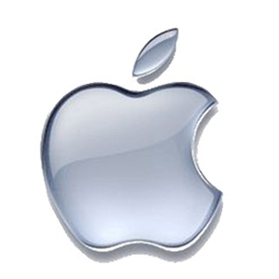
APPLE INC.
Their secret of being world no.1 lies beyond their product line and design standards.
They focus on their UVP, not price wars and “race to the bottom”.
‘Think different’ campaign in 1990s – video footage of 17 iconic 20th century personalities from around the world.
Mac vs P.C. advertisements – technical jargon brought to the audience in a way that would appeal to them.
Smartly capitalized on the universality of that self-perception, which made its customers believe that the brand understands them and is like them.

Slide 14
What they do differently
Apple uses clever product placement(smart watches) and exclusivity technique.
Typically executed with relative success by businesses giving a select subset of customers a special deal on goods or services. For example some companies make certain offers exclusively available to existing customers or Facebook fans.
Unboxing- No one tells people to video their experience, but they do it, from all across the world, because the process is so “Zen” that you can’t help not to.
It has built a GLOBAL community and hardcore fan base.
“If you don’t have an iphone, you don’t have a iphone!”

Slide 15
Samsung
Its global “Next is Now” campaign built anticipation around the launch of its Galaxy phones by previewing its innovative features
Samsung aired Ads during the 2015 Oscars .The ads align with a company-wide commitment to proving that digital innovation can enrich peoples’ lives
Its ongoing “Launching People” campaign, which shares the stories of people who use Samsung products to turn their visions

Slide 16
Samsung
Samsung Galaxy Note 7 , Busy Busy Busy campaign with Christoph Waltz:
Galaxy Note 7 is defined by Cristoph Waltz. The smartphone Galaxy Note 7 allows people to multitask. The ad message says, take a picture of what you do and share extra-curriculars in a fun way
Samsung Unpacking 1988 to 2016: Samsung’s release of the new Galaxy S7, Galaxy S7 edge and Gear 360 is being promoted with a commercial covering the unpacking of new models, from the release of the SH-100 mobile phone in 1988 to the first wristwatch phone, the world’s smallest TV phone to Samsung’s first MP3 phone.

Slide 17
GE
GE’s marketing efforts have focused on new storytelling platforms
35–40 percent of its marketing budget allocated to digital media
Apart from Facebook, Twitter, YouTube, Instagram the company is tapping into platforms like Wattpad, Vine, Tumblr, and Snapchat to spark conversations with audiences and solve real business problems, both by curating new ideas and pushing industry-leading
GE invites Instagram influencers to tour the GE facilities, encouraging them to share this rare look behind the scenes using the hashtag #GEInstaWalk
Just recently, it rolled out a series of commercials with the tagline “The Digital Company. That’s Also an Industrial Company”

Slide 18












Oracle
They spent a lot time and money on R&D(Research & Development) by executing Larry Ellison’s vision “turn the 38-year-old technology leader into the number one cloud company in the world.”
Virtually its entire software is now offered as cloud services.
Cloud Built-in
Purpose Built
General Purpose
Big Data
Exadata
Exalogic
SPARC
SuperCluster

Slide 19
HP
The USP of HP is that it has got largest division in its corporate history.
The company continues to innovate, and its most ambitious research effort is The Machine, which reinvents the fundamental architecture of computers to enable a quantum leap in performance, power efficiency, and security.
Efficient use of communication tools and tactics that HP used
Demand generation.
Sales and marketing tools.
Channel announcement email.
Channel Implementation guide.
Campaign Introduction video.

Slide 20
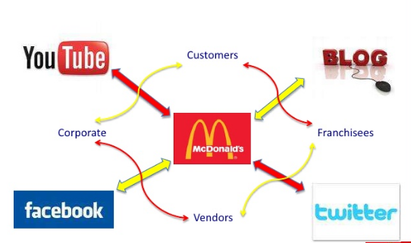
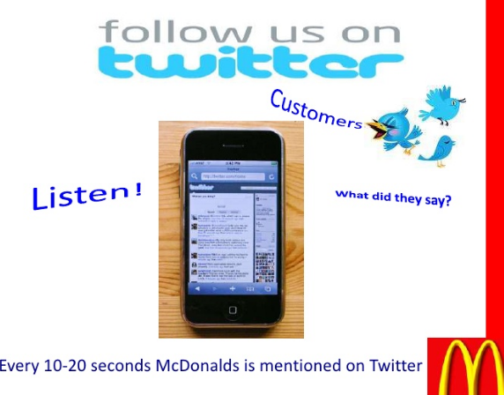
McDonald’s
McDonald's Launches 'Moments of Joy' in 24 Cities #imlovinit campaign . 24 gifts of joy. In 24 cities. Over 24 hours. "Moments of joy" marks McDonald's biggest global push since "I'm lovin' it,"
The company opened up a line of dialogue by expanding its “Our food. Your questions.” initiative, a social media campaign that aims to answer all customer questions transparently
McDonald’s Is the First Brand to Use Snapchat’s Latest Sponsored Geofilters.
Users can head to any US McDonald’s store and use this feature to add more color and life to their snaps. The feature is met with a lot of enthusiasm by fans on twitter

Slide 21

Nike
Nike launched its biggest-ever female focused advertising push with the “Better for It” campaign.
In addition to “Better for It,” there was the whimsical World Cup– themed “Winner Stays On,” a tribute to LeBron James following his NBA defeat, and an ode to the last-place marathon finisher.
They believe in “Change is in the air for Nike.”

Slide 22
Louis Vuitton
Grands Classiques (a French term for “coveted icons”) are new, innovative, and sometimes shocking when introduced, but over time they become classics.
A focus on retail and sales networks, along with a continued emphasis on creativity and quality.
“Don’t believe in borders,” and “dare to new frontiers” are just a few of the sentiments from “The Spirit of Travel,” Louis Vuitton’s campaign film, which values the experience of the journey as much as the destination.

Slide 23
What we can do!
Understand customer behavior - Just because consumers have certain buying preferences or habits in one culture, doesn't mean that such preferences are universal.
Positioning- Good brand positioning includes truly understanding your competition and then looking at your competitive advantage. Who are the providers of similar products and services that you sell in this country?
Find good partners to expand reach.

Slide 24
GLOBALITY
Tata group is a global enterprise operating in more than 100 countries across six continents.
By 2025, TATA will touch the life of one quarter of the world – over 2 billion people served by Tata companies, Tata people and Tata products.
Journey taking us to one quarter of the humanity across the globe.

Slide 25
 | Campaigns | Daily engagement | TATA ke liye
Showcasing history
Global reach
Festivals/important occasions
Something else

Slide 26
Influencer | For history | For reach | For occasions
Celebrity
Proffesional
Civilian

